Slide 1
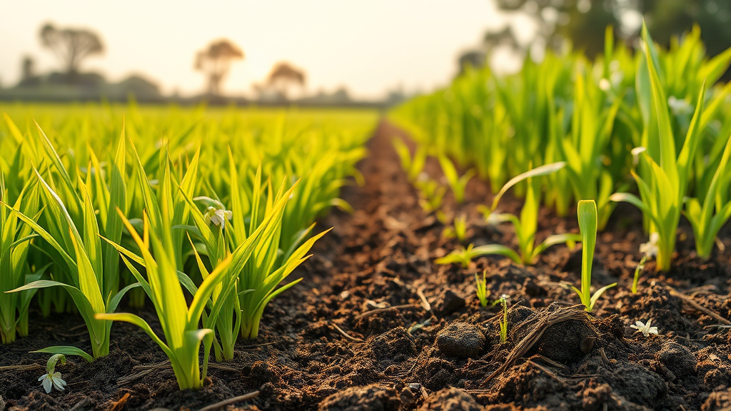
IoT-Enabled Rice Husk Biochar Production
Let’s convert Waste To Wealth

Slide 2
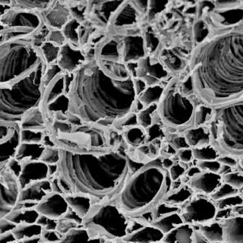
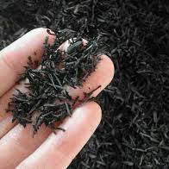
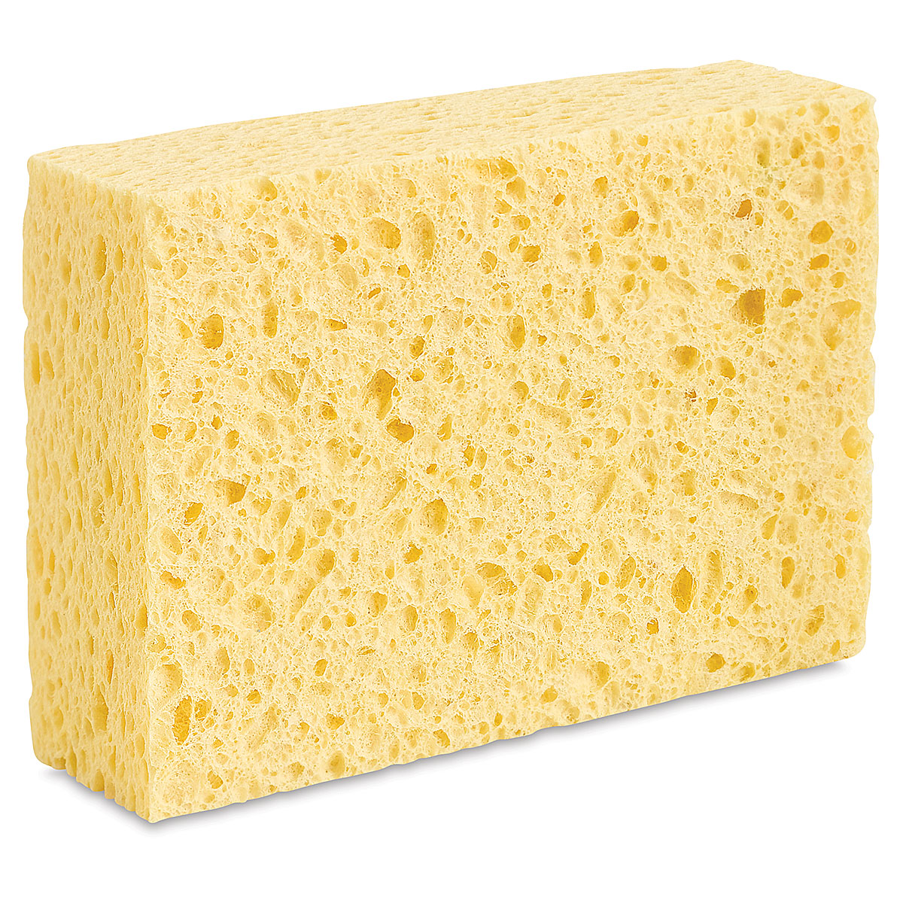
What is Biochar?
Biochar is a stable, carbon-rich solid material that is produced when organic waste (like crop residues, rice husks, coconut husks wood chips, or coconut shells) is heated in a low-oxygen environment — a process called pyrolysis.

Slide 3

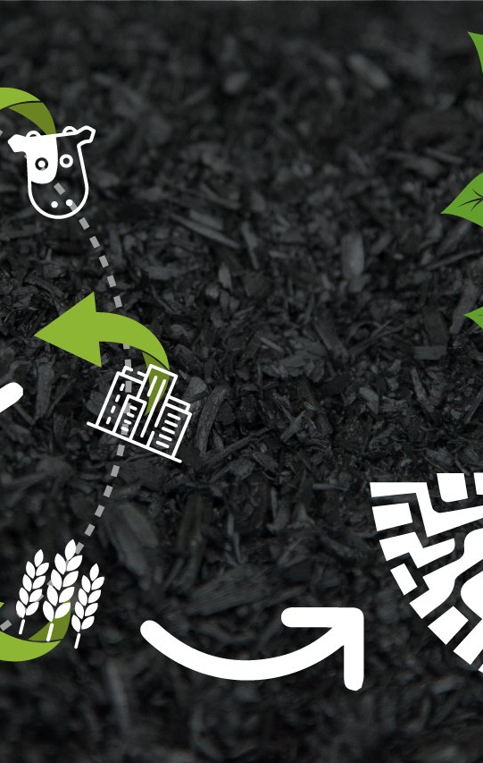
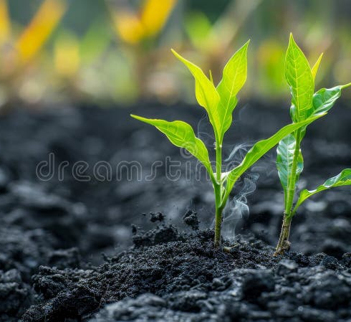
Benefits of Biochar
Improves Soil Fertility
Enhances Water Retention
Better quality of foods
Boosts Crop Yields
Reduces Greenhouse Gas Emissions
Waste Management
Reduced Agrochemical runoff
Reduce Carbon emission

Slide 4
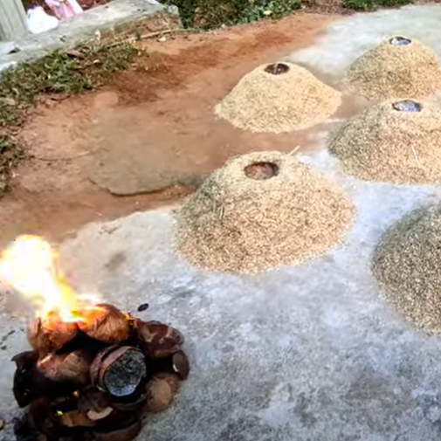
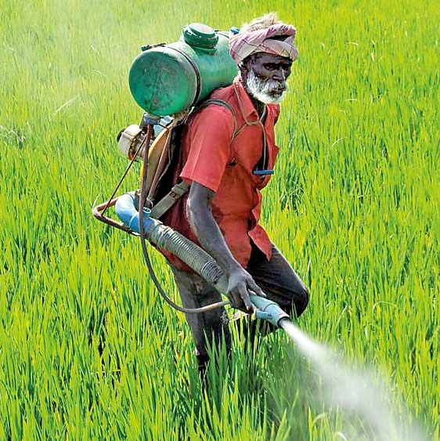
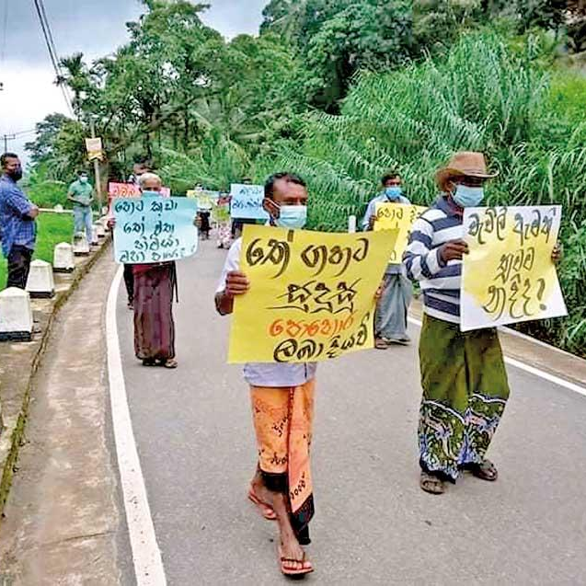
The problem In Sri Lanka
Sri Lanka’s paddy industry generates hundreds of thousands of tons of rice husk annually as an agricultural byproduct. But most of them are openly burned or disposed of without proper utilization.
Air Pollution: Open burning releases greenhouse gases and particulates, contributing to climate change and local health problems.
Wasted Resource: Rice husk contains significant carbon content and potential energy, yet it is largely untapped.
Soil Degradation: Farmers increasingly face declining soil fertility, leading to heavy reliance on costly chemical fertilizers.
Energy Crisis: Rural communities lack affordable, reliable energy sources, while rice husk could provide syngas, bio-oil, and waste heat.
Without an effective strategy, this waste stream continues to harm the environment while farmers struggle with rising costs and poor soil productivity.

Slide 5
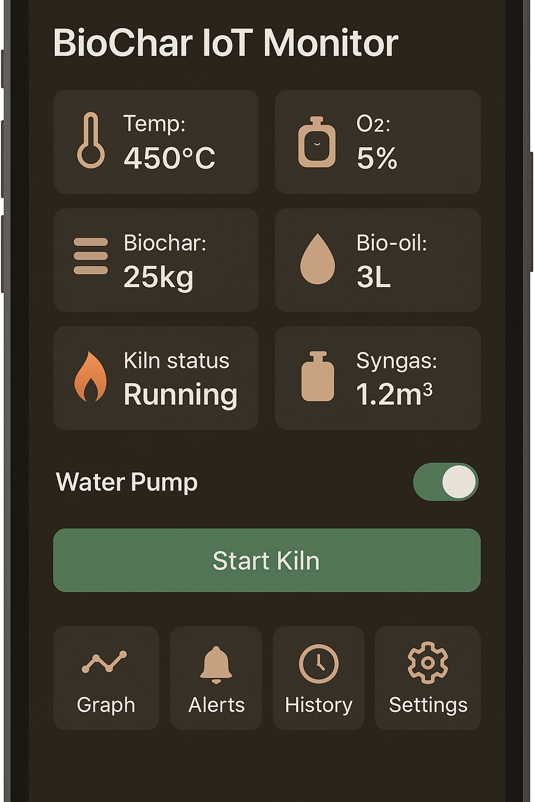
Our IoT-Enabled Solution
Pyrolysis kiln controlled by IoT sensors + ESP32 dev(as an initial stage)
Monitors temperature (400–600 °C) and oxygen flow.
Mobile app shows real-time data & alerts.
Outputs: Biochar, Syngas, Bio-Oil, and Waste Heat.

Slide 6

THANK YOU! Q & A

